Slide 1


ECEN 403 Midterm Presentation
OpenROAD VLSI Design II Kevin Umanzor
Talha Ibrahim
Githin Johny
Giovani Giagnacovo
TA: Hailey Ward
Sponsor: Dr. Kevin Nowka

Slide 2
RTL Design
(Verilog)
Logic Synthesis
Placement
Clock Tree Synthesis
Routing
GDSII/Tapeout
OpenROAD/OpenLane
Notes:
Cost: is the overarching factor, which includes time and money spent on VLSI design experts, licensed software tools, and setbacks caused by design flaws and optimization. OpenROAD: initiative created to democratize hardware design by making more accessible and feasible. (the problem our project looks to solve)

Slide 3
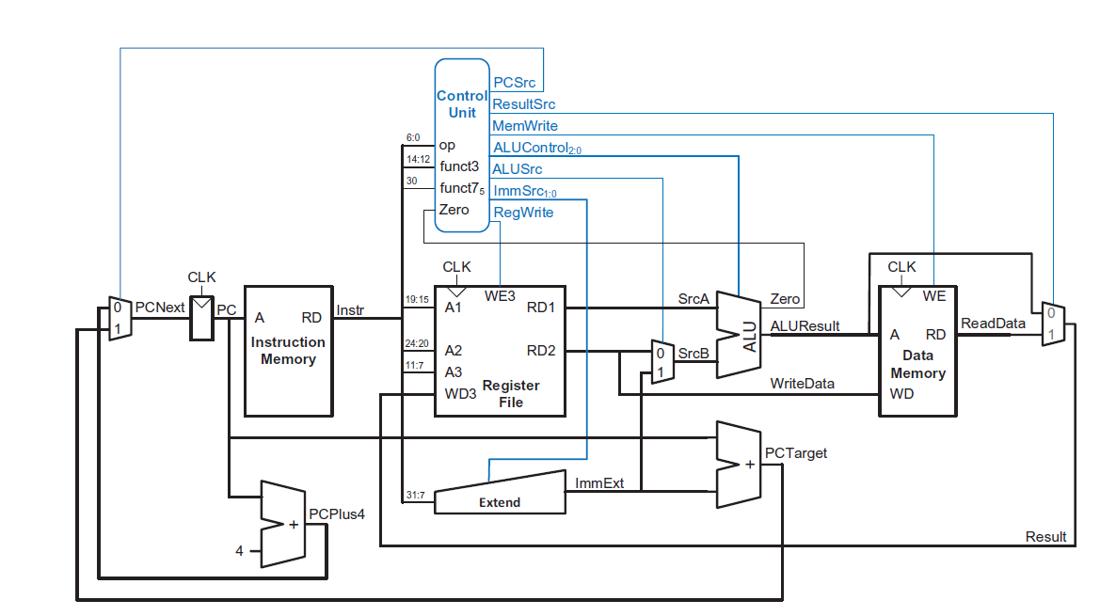
System Overview
Githin
Talha
Giovani
Kevin

Slide 4
System Overview
Talha
Kevin

Slide 5
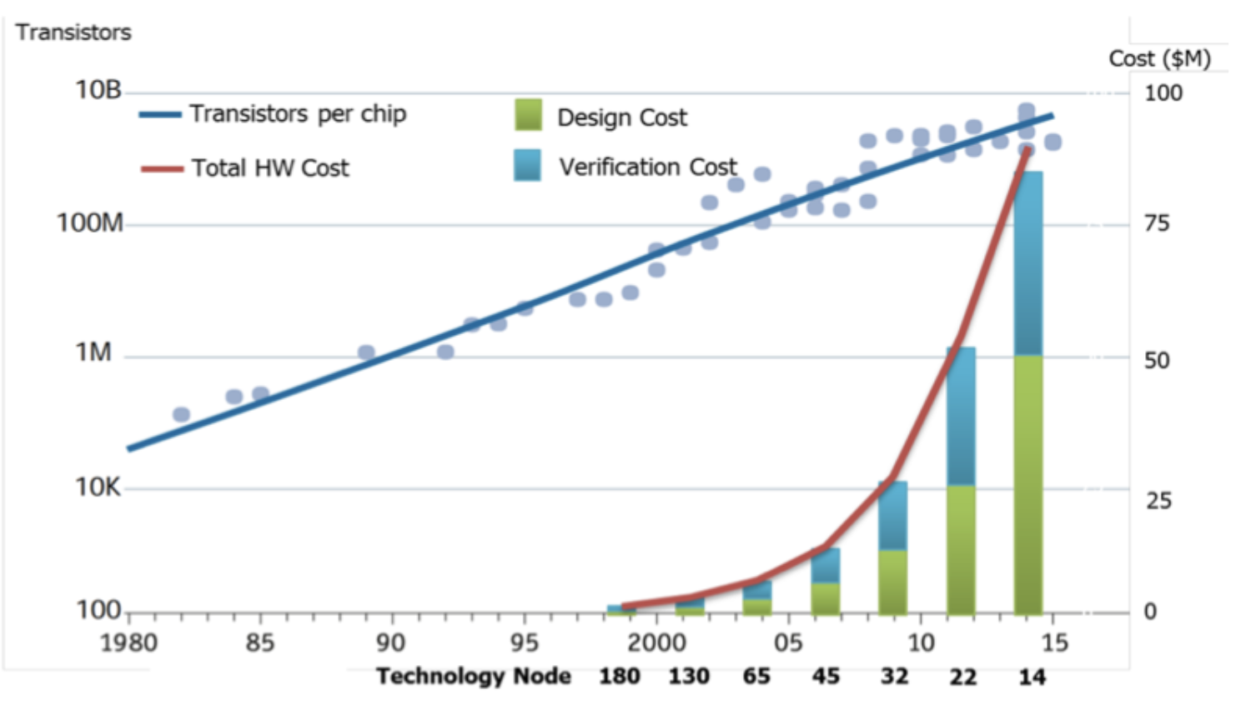
Project Summary
Problem statement:
Traditional RTL-to-GDSII chip design is expensive, creating a cost barrier to developing a System on a Chip (SoC).
Our Solution:
Create a 16-bit RISC-V using OpenROAD, which automates chip design by only needing only an RTL description to generating GDSII, significantly reducing cost.
RTL Design
(Verilog)
Logic Synthesis
Placement
Clock Tree Synthesis
Routing
GDSII/Tapeout
OpenROAD/OpenLane
Notes:
Cost: is the overarching factor, which includes time and money spent on VLSI design experts, licensed software tools, and setbacks caused by design flaws and optimization. OpenROAD: initiative created to democratize hardware design by making more accessible and feasible. (the problem our project looks to solve)

Slide 6
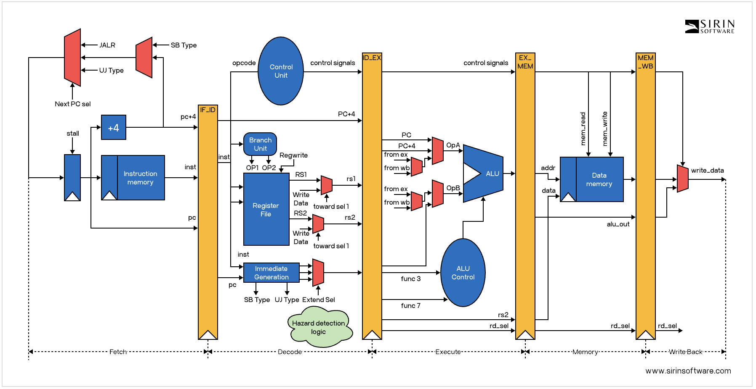


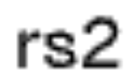
System Overview
Kevin
Githin
Talha
Giovani
Notes:
https://sirinsoftware.com/blog/inside-risc-v-microarchitecture
Talha
Talk about Subsystems and how we will go through EACH component within 403 and then connect in 404.
We plan on going from Verilog to OpenROAD for the big components

Slide 7
Tools and Trade-offs
First Choice | Second Choice | Reasoning
OpenROAD | Licensed EDA tools | OpenROAD is open-source and automated, providing a free and fast design flow. We also save money on licensing.
Single-Cycle | Pipelining | Lower power consumption, better to implement due to 16-bit restriction, and takes less space.
Verilog | VHDL | Verilog is the recommended tool by OpenROAD and is popular amongst VLSI Design
Notes:
tradeoff 1 is the cost licensed costs more so we are saving money additionally openroad saves us time. it is meant to
traeoff 2 single cycle allows for less power consumption and we also save additional space
Verilog was chosen for this design as it is heavily supported by openROAD.

Slide 8
Fetch – Kevin Umanzor
What does the subsystem do?
-Retrieves the next instruction set from main memory (RAM) or data using the Program Counter (PC) and stores it in an internal register for processing. -Updates the PC counter to point to the next instruction.
Connections with other subsystems
-Takes instruction from the Execute stage and works with control logic to handle sequential and branch instructions.
+2

Slide 9
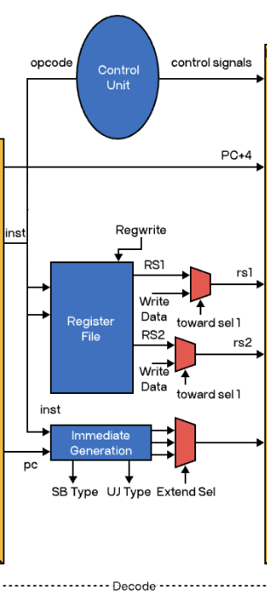
Decode – Githin Johny
What does the subsystem do?
Decodes instructions and generates control signals
Connections with other subsystems
Takes input from the Fetch Stage
Outputs control/operands to the Execute stage
Notes:
what it does: decodes instruction, extract relevant bits to send to individual unit across the system

Slide 10
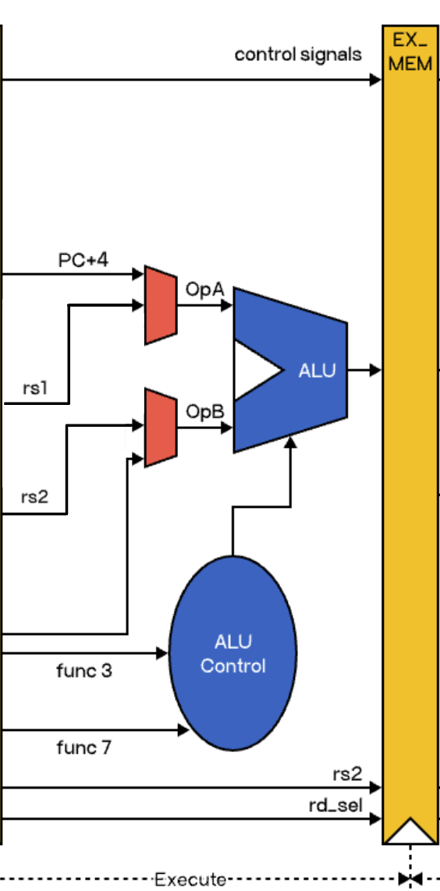
Execution – Talha Ibrahim
What does the subsystem do?
Responsible for performing operations of instructions:
Arithmetic operations
Calculating Memory Addresses
Branching
How will it connect to and interact with other subsystems
Receives operands & control signals
Sends calculated memory/store addresses
Notes:
What does the subsystem do?
How will it connect to and interact with other subsystems (from ICD)

Slide 11
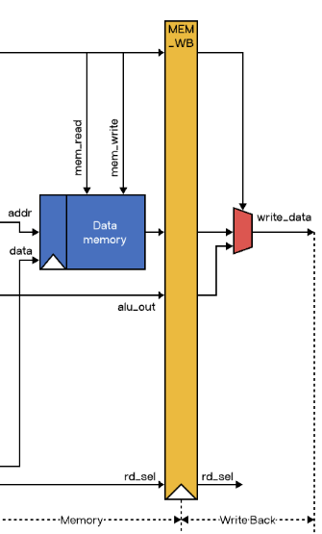
Memory Access – Giovani Giagnacovo
What does the subsystem do?
Loads and stores data from memory and drives output
Connections with other subsystems
Decode: control signals assigned at this stage determine memory access, and what output is driven back to the registers.
Execution: ALU output is fed into the multiplexor.
Notes:
What does the subsystem do? This subsystem represents the portion of the chip responsible for storing and loading data from memory and writing data back into the register file.
How is it being designed? This subsystem is being designed using two main units: the data memory unit and the write back multiplexor. This data memory unit is comprised of an SRAM module and it stores and loads data for usage. The multiplexor to the right selects between ALU output or data read from memory and either writes the data back into the register file or discards it
Key objectives, constraints, metrics (from FSR): The key objectives when designing this subsystem are to ensure that data is being wrote and read from memory properly for each instruction defined in our instruction set and that data that is being written back to the registers properly for future usage. Some constraints on this stage ____ . Some future considerations are how large we want our SRAM to be? ANALYZE THE TRADEOFFS
How will it connect to and interact with other subsystems (from ICD): This subsystem will have several interactions with other subsystems: in the decode subsystem the control unit designates whether an instruction is able to write or read from memory by enabling/disabling mem_read or mem_write signals. Additionally there is a reg_write control signal that determines whether data is written back to a register or discarded. There is a mem_to_reg control signal on the mux to determine which output is chosen. These signals are applied to our SRAM to differentiate between memory read and write instructions and other types. The write back signal is applied to the register file and will determine whether the output of our mux is driven to the register or discarded. There is also interactions with the execution stage as the alu output is directly fed into the mux as this output is driven to the register file instead of memory data if the instruction does not access our memory (signals on SRAM are not enabled)
what it does
what its comprised of
key objectives and connections
NOTE TO SELF NOT TO BE READ*
mem_read → tells the memory unit to read from the address.
mem_write → tells the memory unit to write to the address.
reg_write → tells the register file whether to perform a write in the WB step.
mem_to_reg used to select between memory output and ALU on the mux
👉 These are binary flags (0/1), generated by the control unit after decoding the instruction.
addr → the address coming from ALU (where in memory to access).
data → the value to store into memory (from register RS2).
alu_out → the arithmetic result from EX (either used directly, or as addr).
rd → the destination register index (from instruction bits).
write_data → the final value written into the register file (either alu_out or memory output).

Slide 12
Project Execution & Validation
 | 9/30 | 10/14 | 10/28 | 11/11 | 11/25
Fetch - Kevin Umanzor | Complete design of the 16-bit RISC-V ISA | Implement the Verilog for Program Counter (PC) & Instruction Memory | Successfully pass the Testbench for PC & Instruction Memory | Implement PC & Instruction Memory within OpenROAD | Validate OpenROAD design of PC & Instruction Memory
Decode - Githin Johny | Complete design of the 16-bit RISC-V ISA | Implement the Verilog for the Control Unit, Register file, and Add Immediates | Successfully pass the Testbench for Control Unit, Register file, and Add Immediate | Implement Control Unit, Register file, and Add Immediate within OpenROAD | Validate OpenROAD design using Static Timing Analysis
Execution - Talha Ibrahim | Complete design of the 16-bit RISC-V ISA | Implement the Verilog for the ALU & ALU Control | Successfully pass the Testbench for the ALU & ALU Control | Implement ALU & ALU Control within OpenROAD | Validate OpenROAD design of ALU & ALU Control
Memory Access - Giovani Giagnacovo | Complete design of the 16-bit RISC-V ISA | Implement the Verilog for the memory unit (SRAM cache) | Develop the testbench for the memory unit | Implement the memory unit within OpenROAD | Validate OpenROAD design of memory unit
Notes:
RISC 5 !!!!!!!!!!!!!!!!!!!!!!!!!!!!!!!!!!!!!!!!!!!!!!!!!!!!!!!!!!!!!!!!!!!!!!!!!!!!!!!!!!!!!!!!!!!!!!!!!!!!!!!!!!!!!!!!!!!!!!!!!!!!!!!!!!!!!!!!!!!!!!!!!!!!!!!!!!!!!!!!!!!!!!!!!!!!!!!!!!!!!!!!!!!!!!!!!!!!!!!!!!!!!!!!!!!!!!!!!!!!!!!!!!!!!!!!!!!!!!!!!!!!!!!!!!!!!!!!!!!!!!!!!!!!!!!!!!!!!!!!!!!!!!!!!!!!!!!!!!!!!!!!!!!!!!!!!!!!!!!!!

